Slide 1

CREDIT SCORE PREDICTION
AI(101B)
MASTER OF COMPUTER APPLICATION
Team Leader: Anik Arya (202410116100025)
Members:
Ashutosh Chaubey (202410116100042),
Anubhav (202410116100036),
Anchal (202410116100024)
Project Supervisor:
Mr Apoorv Jain
Assistant Professor

Slide 2

Credit Score Prediction: An AI-Powered Approach with Python
Discover how artificial intelligence and Python can revolutionize credit score prediction. This presentation explores AI-driven methods for more accurate and ethical credit assessment.

Slide 3

Understanding Credit Scores
Importance of Credit Scores
Components
Key factors include payment history and amounts owed.
Credit scores affect loan interest rates and approvals.
Implications
Ranges can significantly impact financial opportunities.
Credit scores are vital for financial health. Understanding their components is crucial for improving them.

Slide 4
AI Revolutionizes Credit Scoring
Traditional Limitations
AI Benefits
Traditional methods often lack accuracy and are prone to bias.
AI offers increased accuracy and reduced bias by analyzing complex data.
AI algorithms provide enhanced analysis. Ethical considerations are paramount in AI-driven credit scoring.

Slide 5




Python Libraries: The Toolkit
Python
Pandas
Scikit-learn
Accessible and easy to learn.
Great for data manipulation.
Effective for machine learning.
Python is the language of choice. Pandas and Scikit-learn are essential for data analysis and machine learning.

Slide 6




Data Mastery: Preprocessing & Engineering
Clean Data
Handle missing values and outliers.
Scale Features
Apply feature scaling and normalization.
Select Features
Use correlation analysis.
Effective preprocessing is essential. Feature engineering creates valuable new data points.

Slide 7
Model Building and Training
Split Data
1
Training vs. testing.
Train Models
2
Evaluate performance.
Training involves splitting data and tuning parameters. Model performance is key to accuracy and reliability.

Slide 8

System Integration
User Interface
Cloud Deployment
Create a user-friendly interface using Flask or Streamlit.
Deploy the model to AWS, Azure, or Google Cloud.
System Integration
Integrate AI into existing systems.
Effective deployment is key for accessibility. Monitoring and retraining ensure ongoing performance.

Slide 9
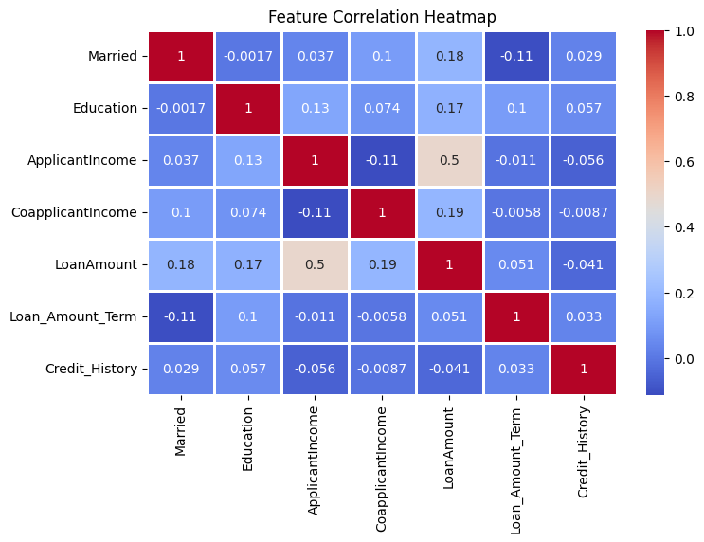
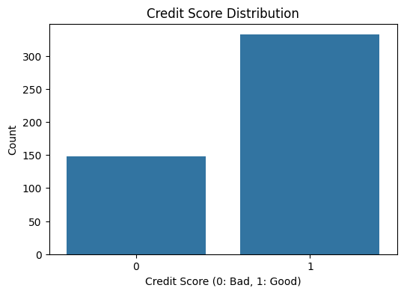
VISUALIZATION

Slide 10

Conclusion & The Road Ahead
Key Benefits
Financial Applications
Enhanced credit score predictions.
Numerous uses in the financial industry.
Future Research
Explore explainable AI and federated learning.
AI offers transformative potential. Further research will enhance fairness and transparency.

